Slide 1
The Data of Death
Or How I Learned to Stop Worrying and Love Rush Hour

Slide 2
Initial Questions
Are there trends within vehicular fatalities data that could lead to a reduction in such fatalities?
Where would such data be acquired?
What methods could be used to souse out these patterns?

Slide 3
Data Set
Data.gov poses data sets on vehicular fatalities from 2006 to 2013.
While all relevant data sets could have been chosen, limits to available processing power made using just one years data more useful.
2013 was chosen as it is the most recent data set.

Slide 4
Data Set (Continued)
Total Rows: 30,358
Total Columns: 53
Total Data: 1,608,974
The shear volume of data immediately calls for a application of big data analytical techniques

Slide 5
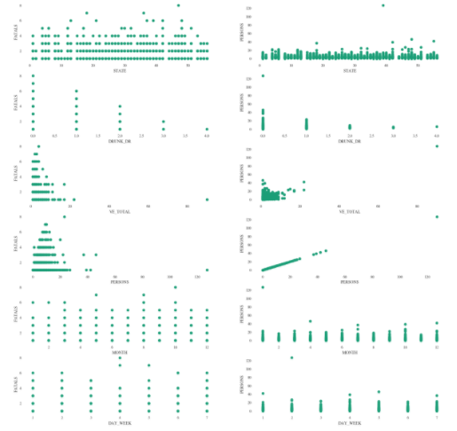
Analysis
Step one Scatter Plot visualization:

Slide 6
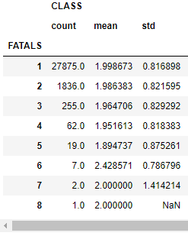
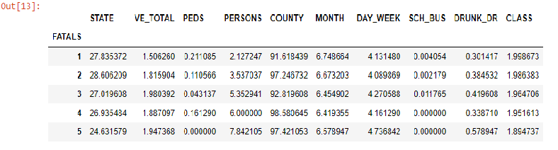
Grouping

Slide 7
Conclusion
Further analysis requires a key for the numbering schema, especially for states, county, and geolocation.
This data could then be used to build a heat map.

